Slide 1

Training Session
Monday, 3 July 2017
Notes:
Zum Ändern des Hintergrundbildes der Titelseite in Ansicht > Master > Titelmaster wechseln. Dort das aktuelle Bild löschen und das neue über Einfügen > Bild > Von Datei einfügen. Dann durch Rechtsklick das neue Bild in den Hintergrund bzw. ganz nach hinten verschieben.

Slide 2
eRecruiter structure
Accounts
Applicants
account portal
Jobs
applicant portal
recruiting agency portal
Workspace

Slide 3
Training goals
Basic functions of the eRecruiter:
  How to create a new job, job ad and publish it
  How to create applicants
  How to work with your applicants:
    Rejections, invitiations, forwarding
  How to find applicant profiles again

Slide 4
Addresses
eRecruiter backend: https://app.erecruiter.net
eRecruiter applicant portal: http://xyz.bewerberportal.at
eRecruiter account portal: https://portal.erecruiter.net
Login details:
  User = E-mail address
  Password = eRecruiter

Slide 5
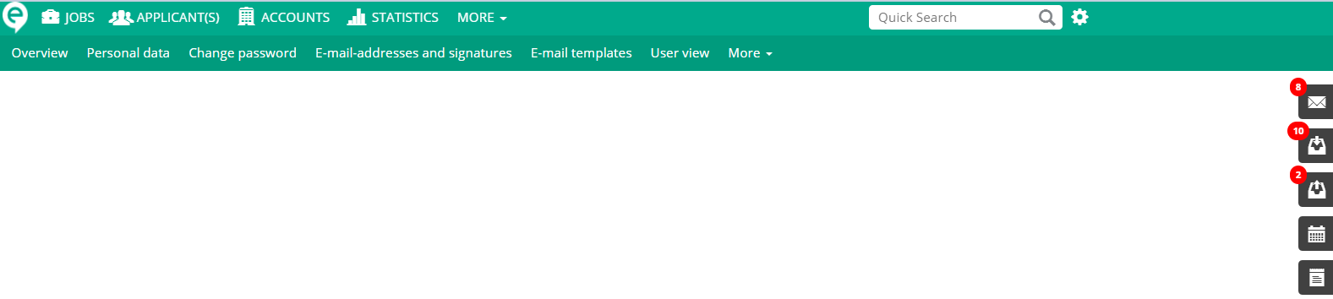
General screen structure
settings
search
main navigation
detailed navigation
notification center
actions

Slide 6
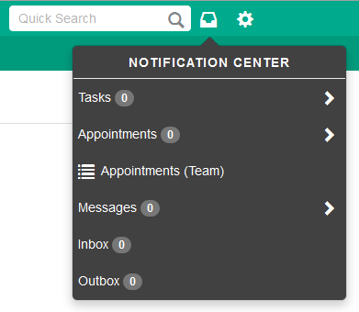
Notification Center
My tasks
My appointments + appointments of colleagues
Messages (e.g. from account portal)
Inbox (imported E-mails from Outlook Plugin)
Outbox (not yet sent E-mails)

Slide 7
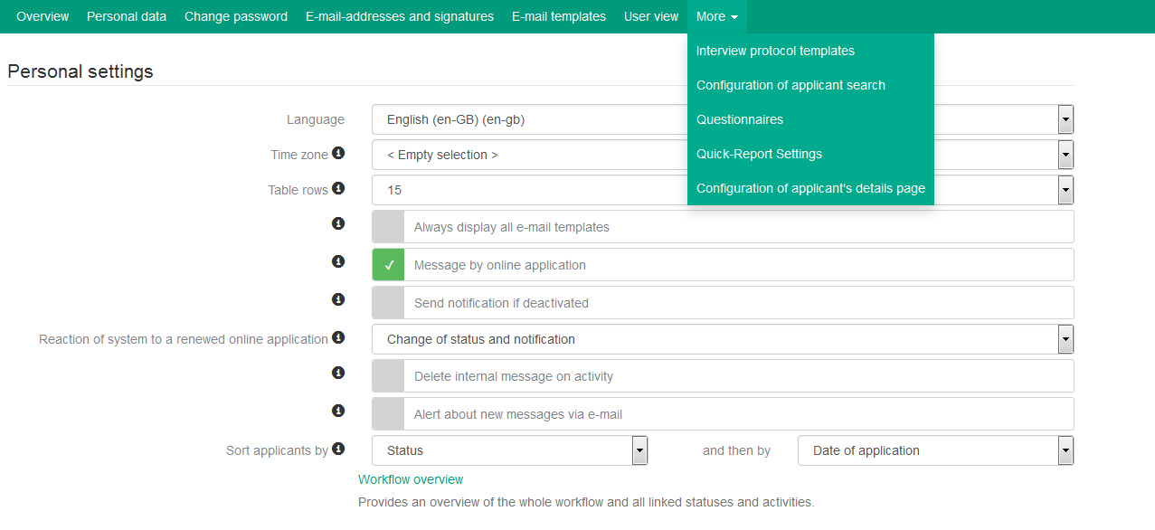
Settings
Personal data , E-mail adresses and signatures
E-mail templates and templates for interview protocols
Workflow overview
Configure applicant search, applicant detail page and sorting
E-mail templates, templates for interview protocols and questionnaires

Slide 8

How to create a job-ad?
1
2
3
4
5
1. create job for an account
2. base data for the job (Locations of job, contact, job profile, etc.)
3. enter texts and choose a template for the Job ad
4. Publish (applicant portal, job portal, etc.)
5. send to account portal

Slide 9

Task
Create a job for an already created account.
Do all steps mentioned above.
Take a look at the finished Job-Ad by using the action.
Publish the job on your applicant portal.

Slide 10

Applicants
Applicants can apply/register:
  via career portal (online application)
  via E-mail (Outlook plugin or E-mail import)
  via manual entry (postal application)

Slide 11
Task
Apply online to your previously published job:
  With your own E-mail address
  With your phone number
  Add to the applicant detail page:
    Education
    Skills
    Professional requirements
As an alternative you can also create an applicant manually
  Assign the applicant to your test job by clicking „Add to Job“

Slide 12
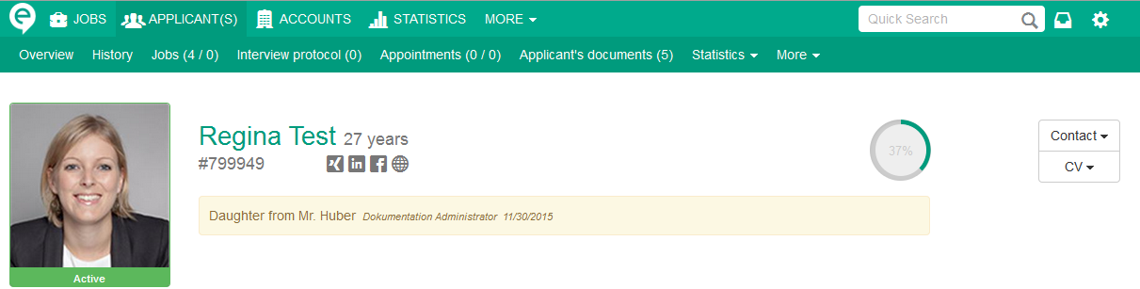
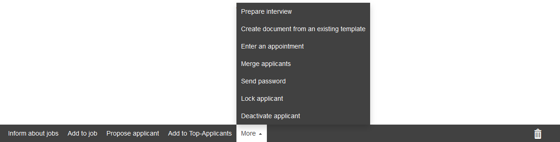
Applicant detail page
jobs (open / closed)
applicant‘s documents
CV
telephone/E-mail
profile completness
active/inactive
actions („more“)

Slide 13
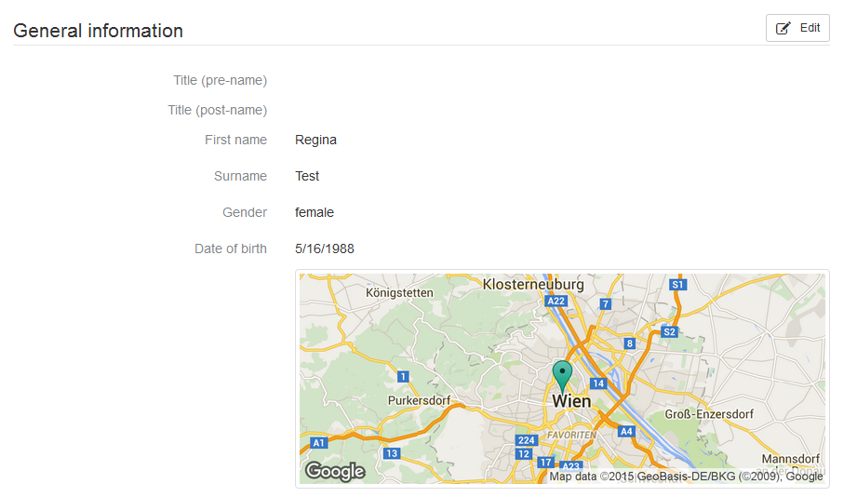
Applicant detail page
applicant‘s residence
Detail page with navigation for fast access (order can be changed)
Data of online application from applicant => Beware!
These details are searchable with applicants search

Slide 14
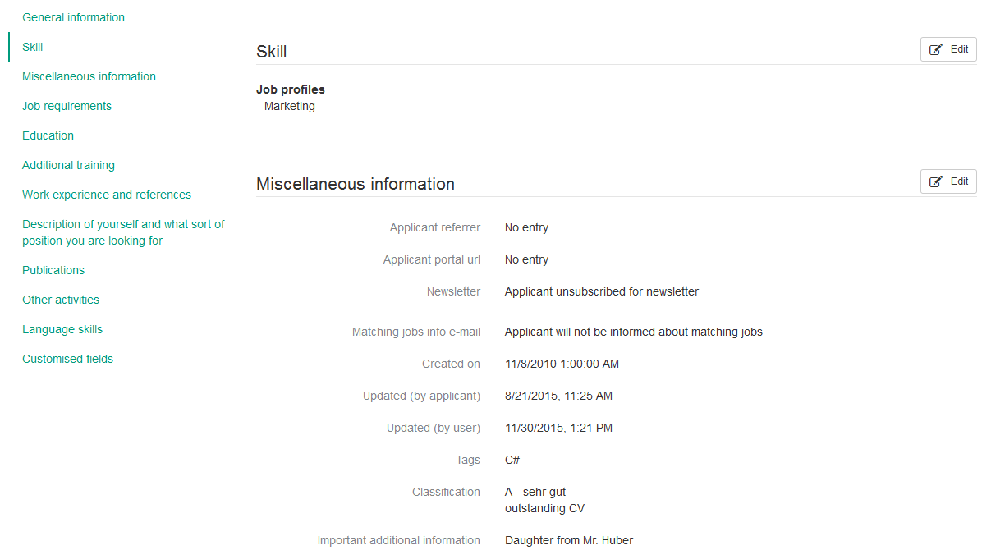
Applicant detail page
job profiles
tags
classification (not job dependent)

Slide 15
Applicant detail page
What data can an applicant see?
Simple basic rule: everything, with these exceptions:
  Classification
  Customized fields (except for questionnaire-fields)
  Internal(!) documents
  Important additional information (icon)
  Tags from the user
  Interview protocol

Slide 16
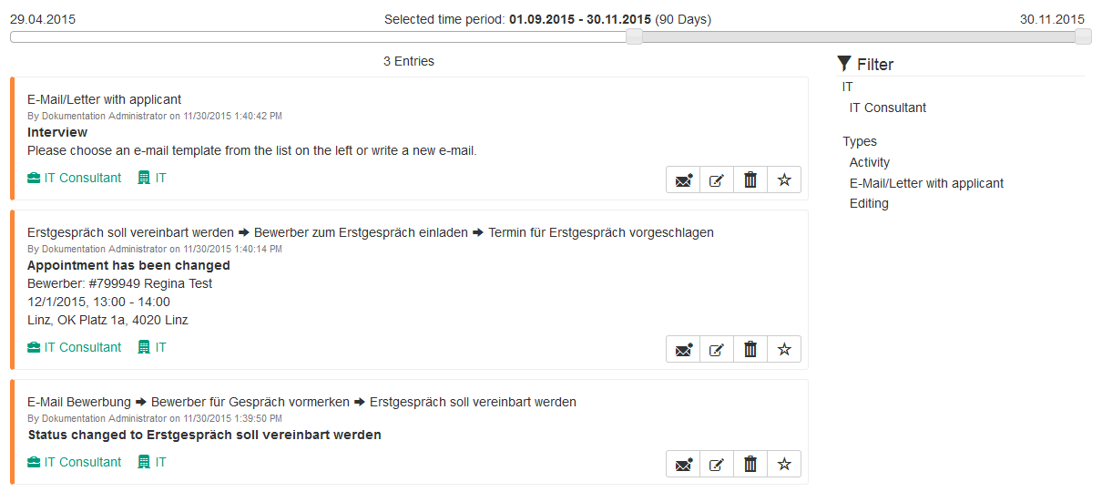
History
Filter
time period (slider)
color-codes

Slide 17
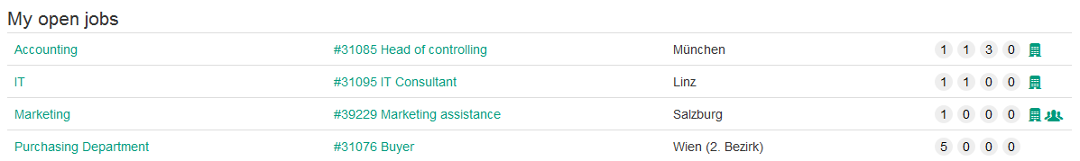
Workspace: working with applicants
visibility on applicant portal
visibility on account portal
account name
job name
location of job (internal)
number of applicants for each open group

Slide 18
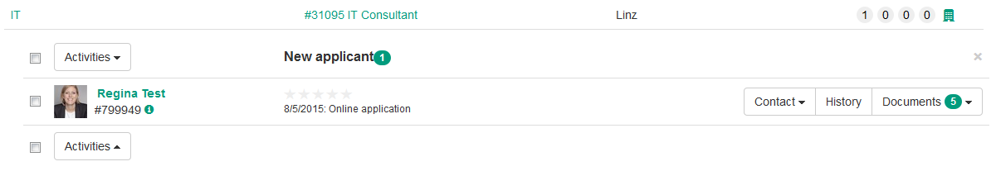
Workspace: working with applicants
Workflow
„applicant for job“
- rating
Applicant group
To applicant detail page
Current status
Applicant‘s history
documents
(incl. CV)
latest
WF-Activity

Slide 19
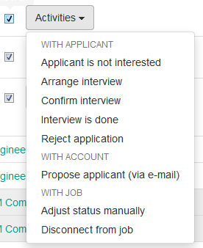
Workspace: working with applicants – workflow
Select an applicant by clicking the checkbox next to the applicant‘s name -> choose action
Also works for more than one applicant (if the workflow status allows it)
Scheme:
An applicant might switch between activity groups (4 groups for active applicants + rejected applicants + hired applicants)
Status
Status
Action

Slide 20
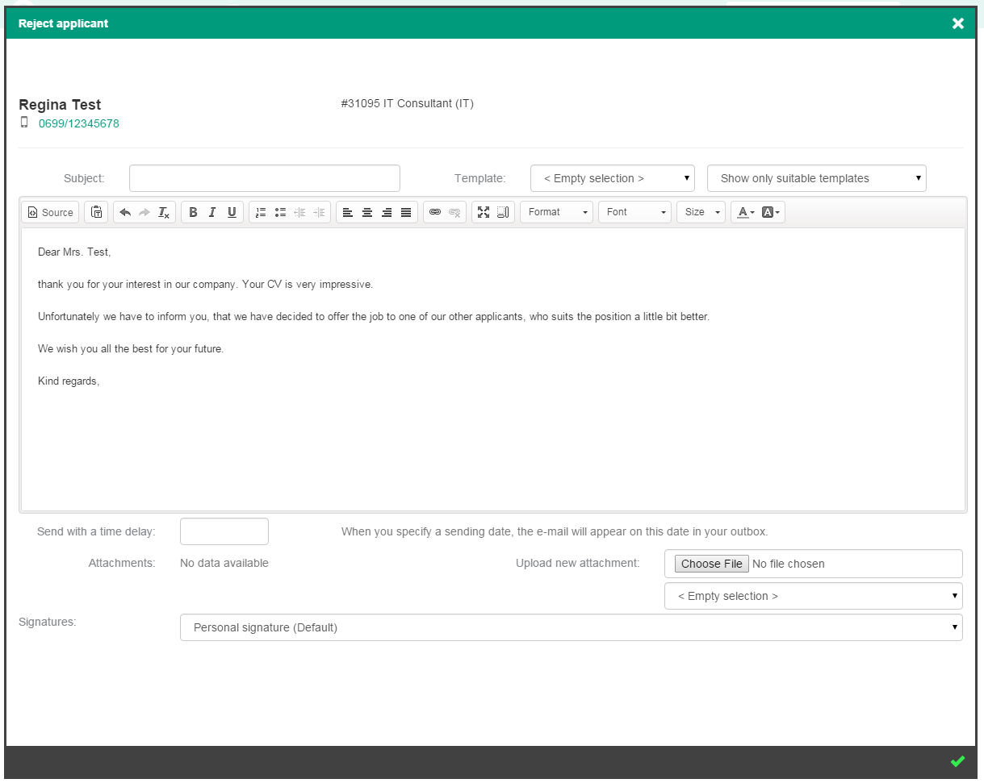
Workspace: working with applicants – communication
subject
all templates/only suitable templates
time delay
attachments
signature

Slide 21
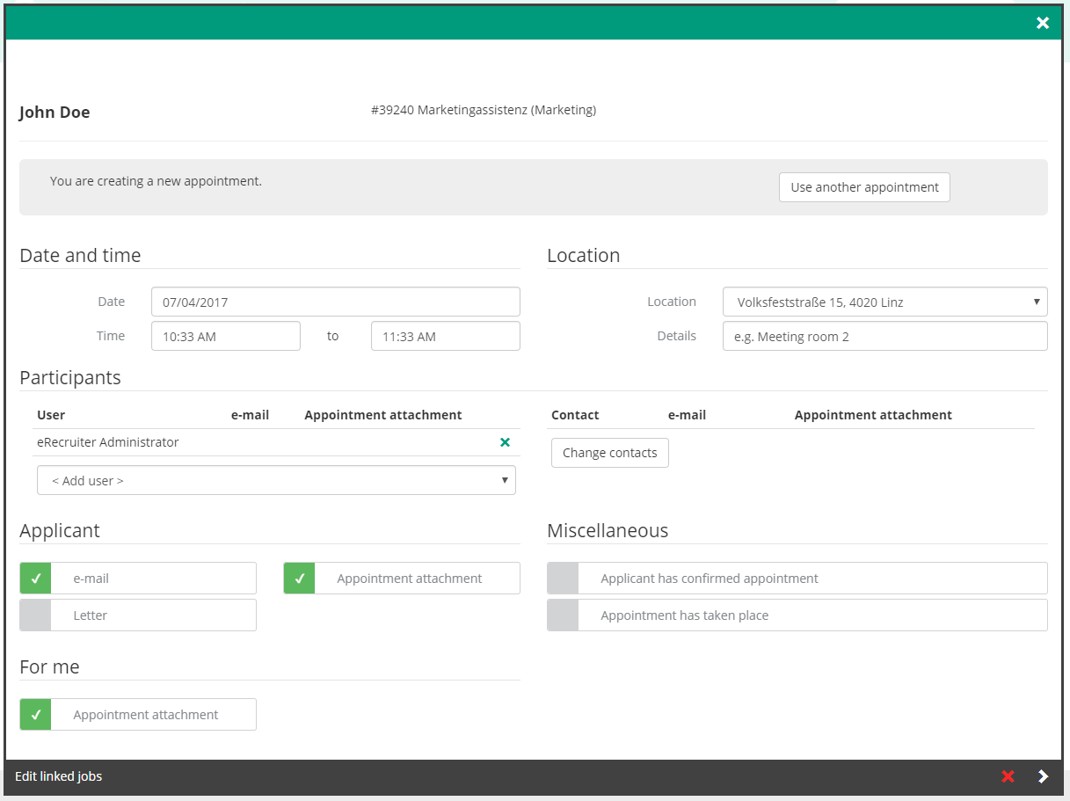
Workspace: working with applicants – appointments
eR User
account
applicant
Workflow-shortcut

Slide 22
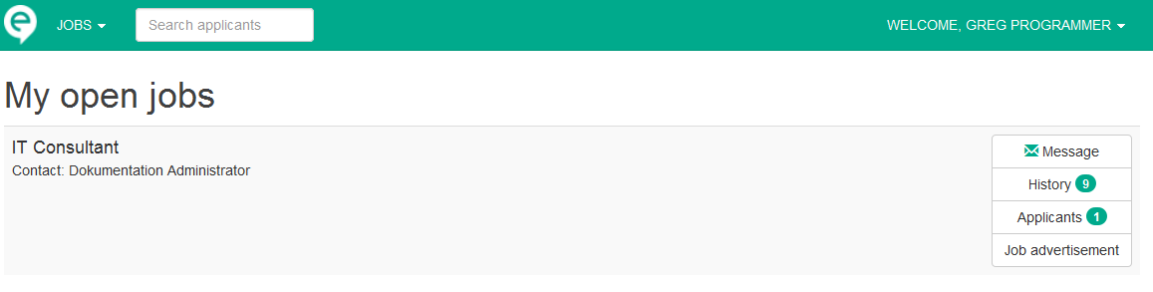
Account portal
Via workspace => account portal – icon (next to job) => Auto-LogOn URL
Contact person will be notified by E-mail through a specific workflow step
account portal from contact‘s view:
contact person‘s name
open/closed jobs
contact the recruiter
job history
applicant overview
open job ad

Slide 23
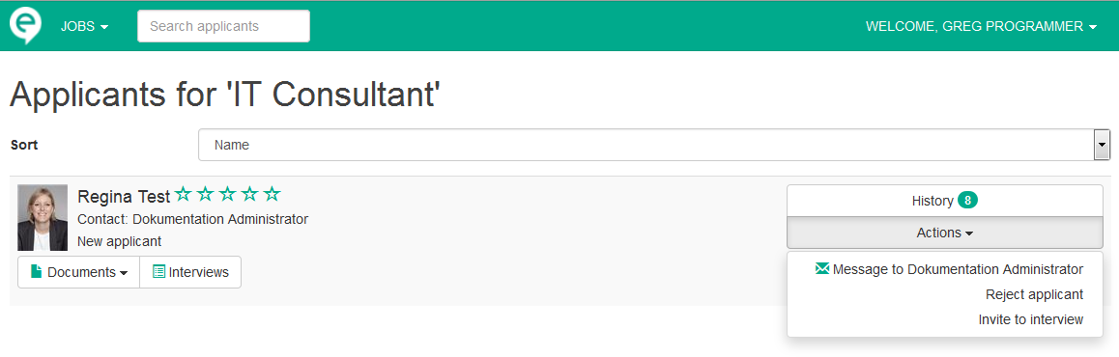
Account portal – applicant page
Status at the account portal*
Document view (which documents can be seen is adjustable)
possible actions *
* equals status and activity on eR-Backend but has often a different name at the account portal

Slide 24

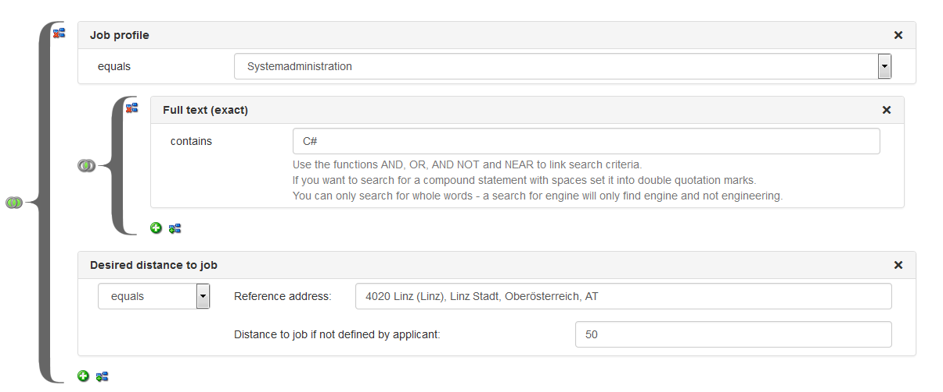
Search
Quick search: for applicants, accounts, jobs
Applicant search
  AND, OR, NOT queries
  Saveable
  Full text search through documents
  Search through history
  Search through customised fields
  Search through all details of applicant’s profile

Slide 25

Statistics
Which jobs have been opened, finished and canceled?
Where are my applicants coming from? (Homepage, platform)
How many applications have I received in a certain time period?
Which applicants were hired?
Own jobs / applicants / accounts always delivers a detailed list with Excel export functionality

Slide 26
Support
Phone
  +43 (0)732 611 221 -66 and +43 (0)1 523 8207 -66
  +49 (0)511 536 7750 -6
E-mail
  support@eRecruiter.net
eRecruiter Knowledge Base (Wiki)
  https://support.erecruiter.net/

